Slide 1
NAME :SANTOSH KADAKOL COURSE :MECHANICAL ENGG REG NO :178ME16052 SUBJECT : PROFESSIONAL PRACTICES

Slide 2
NANOMATERIALS

Slide 3
CONTENTS
INTRODUCTION
HISTORY
CLASIFICATION OF NANOMATERIALS
PROPERTIES OF NANOMATERIALS
APPLICATIONS
ADVANTAGES AND DISADVANTAGES

Slide 4
INTRODUCTION
Nparticles are different from bulk materials and isolated molecules because of their unique optical electronic and chemical properties.
Closely related to size-induced changes in the electronic structure are the optical properties of nanoparticles.

Slide 5
history
1974 the word nanotechnology first coined by nario taniguchi,univ.
1981 IBM invented STM scanning tunneling microscope witch can move single atoms around.
1985 new form of carbon discovered– c60 buckminister fullerene 60 carbon atoms arranged in a sphere made of 12 pentagons and 20 hexagons.

Slide 6
Classification of nanomaterials
Zero dimensional nanomaterial
One dimensional nanomaterial
Two dimensional nanomaterial
Three dimensional nanomaterial

Slide 7
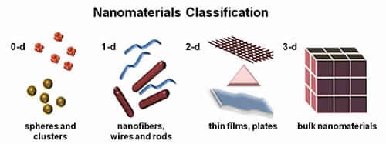
ZERO DIMENSIONAL NANOMATERIAL
Length,breadth and heights are confined at single point.
Example:nano dots,nano particles

Slide 8
ONE DIMENSIONS
It has only one parameter length or breadth.
Example:nanowires and nanotubes.

Slide 9
TWO DIMENSIONS
It has only two parameter length or breadth or height.
Example:very thin surface coutings.

Slide 10
THREE DIMENSIONAL
It has all parameter of length,breadth and height.
Example:crystals.

Slide 11
PROPERTIES OF NANOMATERIALS
The nanomaterial have high strength, hardness, formability and toughness.
These materials exhibit super pasticity even at lower temeratures.
Size of the grains controls mechanical,electricle,opticle,chemical and magnatic property.
The magnetization and coercivity are higher.

Slide 12
APPLICATIONS
Nanomaterials are used for the fabrication of single processing elements.
such as: filters,delay lines,switches, etc.
These materials are used to make semiconductor lasers,nanomaterials,memory device.
Hydrogen-based sensors made by nanomaterials are used in power generation.

Slide 13
ADVANTAGES
Low maintenance.
Fix micro cracking.
Corrosion-resistance.
Low life-cycle cost.
Improve segregation resistance.
Reduces the thermal transfer rate.

Slide 14
DISADVANTAGES
Require a lot of energy.
Price.
Nanotubes might cause a lung problem.
The research is in its early stage yet.

